Slide 1
Grain Biosecurity
Lesson 3 | Insect Identification

Slide 2
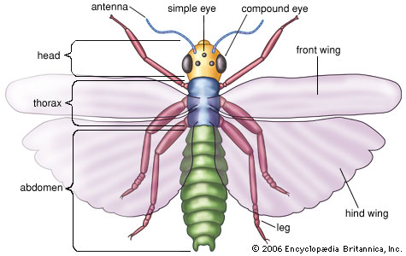
What is an insect?
Antenna
Simple eye
Head
Compound eye
Thorax
Front wing
Abdomen
Hind wing
Leg

Slide 3
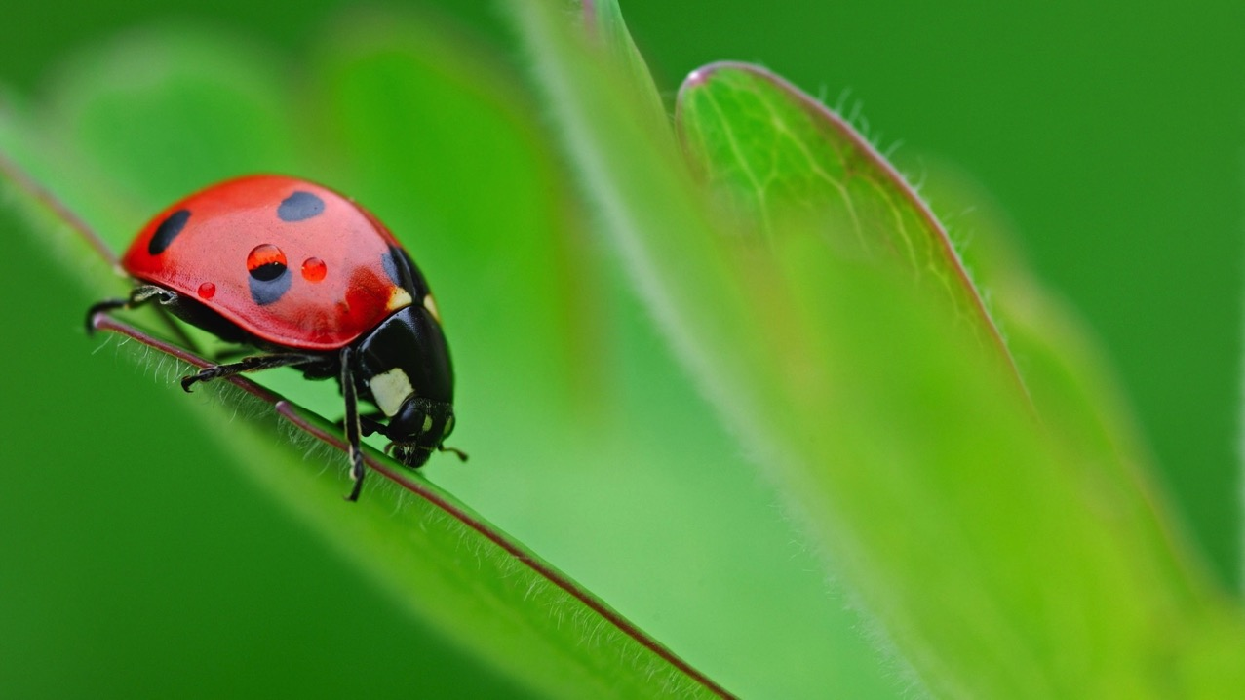
How do you classify insects?

Slide 4
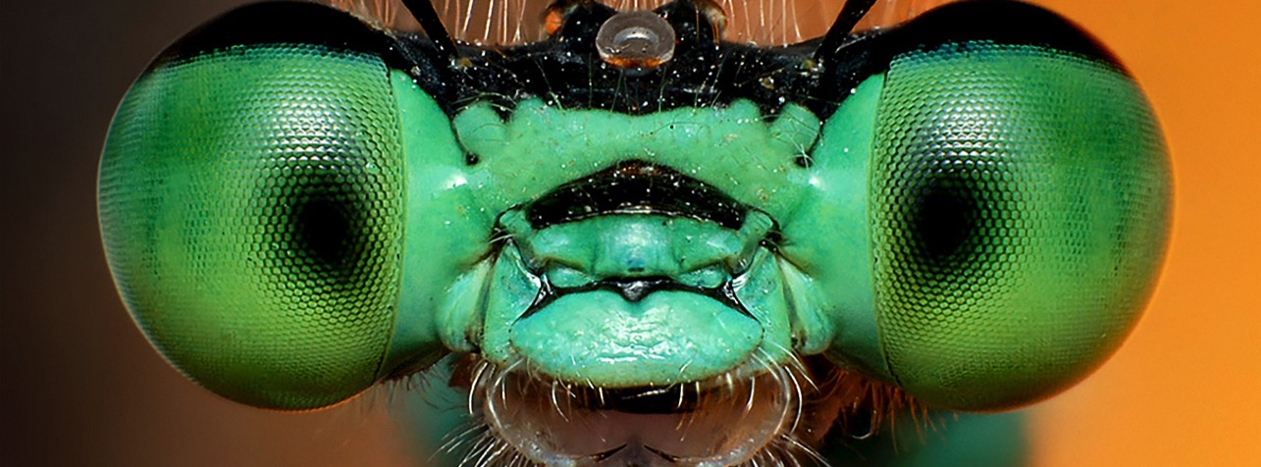
Classifying insects
KINGDOM
PHYLUM
CLASS
ORDER
FAMILY
GENUS
SPECIES
Classification is the grouping of organisms based on common features. There are levels of classification, the further you go, the more alike the organisms. When classifying insects you look for common features like wings, mouthparts and antennae. Colour, size and shape are not really important until you get to the species level.

Slide 5
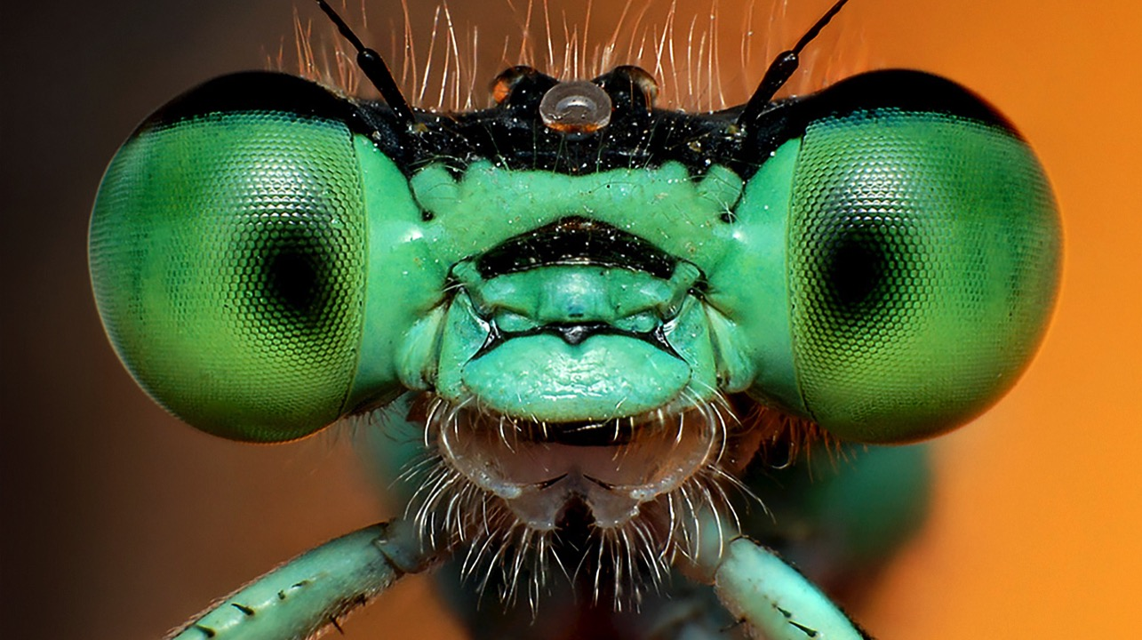
KINGDOM
Animalia
All animals
PHYLUM
Arthropoda
All arthropods (animals with exoskeletons)
CLASS
Insecta
All insects
ORDER
Hymenoptera
Just bees, ants & wasps
FAMILY
Formicidae
All ants
GENUS
Myrmecia
Approx 4,000 species
SPECIES
desertorum
Just Bulldog ants

Slide 6
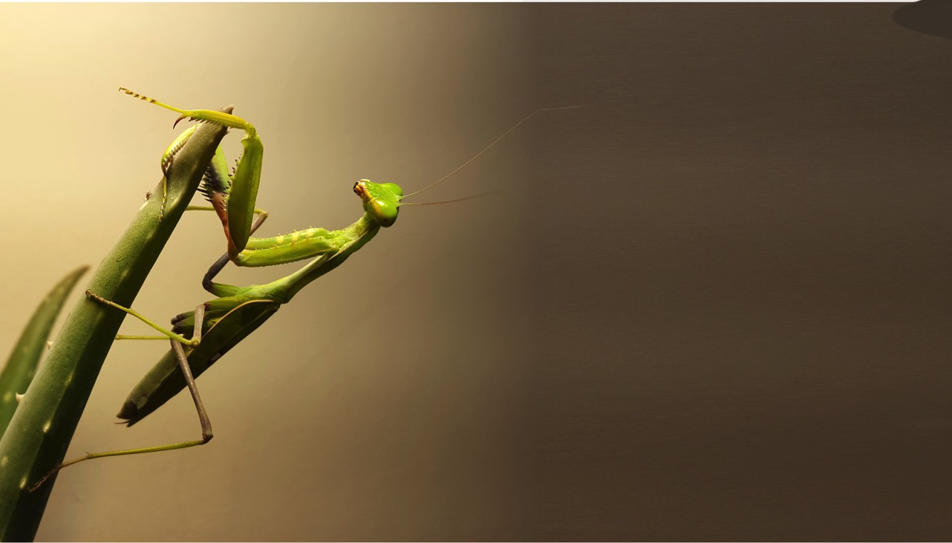
Classifying an insect
1
6
Two pairs of wings
One pair of wings
3
5
2
Front wings form a protective cover
Front wings don’t
form protective cover
Sucking mouthparts
3
Chewing
mouthparts
4
Wings not rigid
Wings rigid & meet in straight line down back
1
2
5
4
Head free and exposed
Head hidden by hood-like structure
Beetle
Coleoptera
6
Front legs with strong spines for grasping
Cockroach
Blattodea
Praying Mantis
Mantodea

Slide 7
Classifying an insect
1
One pair of wings
Two pairs of wings
1
2
Front wings don’t
form protective cover
Front wings form a protective cover
2
3
3
Front and hind wings have similar texture
Front and hind wings different
4
4
Wings covered with scales
Wings membranous
5
5
Mouthparts are a coiled tube
Butterfly or moth
Lepidoptera

Slide 8
1
Classifying an insect
Two pairs of wings
One pair of wings
2
Front wings don’t
form protective cover
Front wings form a protective cover
3
Front & hind wings are different
Front & hind wings have similar texture
1
4
2
Wings membranous
Wings covered in scales
3
5
4
6
5
Wings slope down like a roof
Wings don’t slope down
6
Front & hind wings similar size
Front & hind wings different size
7
7
Body has a narrow ‘waist’
Wasp, bees & ants
Hymenoptera

